Slide 1
Test Levels and Test Types
2023

Slide 2

Gergő Máté Nagy
Senior Software Quality Engineer – QA lead
Gergo_Mate_Nagy@epam.com

Slide 3
Test Levels

Slide 4
Test Phases or Levels
Software testing levels are the different stages of the software development lifecycle where testing is conducted.
What we are going to talk about
  Typical testing objectives for each level
  Test basis for each level
  Tools, environment for each level
  Test participants for each level

Slide 5
Component (Unit) Test
Objective: Find Bugs, build confidence and reduce risk in the individual pieces of the system under test prior to system integration.
Item Under Test (IUT): functions, classes or larger components
Basis: Code, technical requirements
Environment, tools: Development environment, drivers and stubs
Responsible: Usually programmers, but level of proficiency and degree of execution varies.

Slide 6
Unit/Component Test Process
Often, bugs are fixed upon being found without any reporting, which reduces the transparency of the development process with respect to quality
Test-driven development
  Develop a set of unit tests
  Build and integrate code
  Run the test and debug until the test pass

Slide 7
Drivers and Stubs
During Unit, component, and integration testing – and for testing APIs – it’s often necessary to simulate parts of call flow reachable from module(s) under test
Data setup sometimes necessary, also
Driver: functions(s) that call module(s) under test
Stub: function(s) calls – directly or indirectly – by module(s) under test

Slide 8
Integration Test
Objective: find bugs, build confidence, and reduce risk in the relationships and interfaces between pairs and groups of components in the system under test as the pieces come together.
Item Under Test: Two or more integrated components
Basis: architecture, technical requirements, dataflows
Environment, tools: Development environment, Test Environment, drivers and stubs
Responsible: Ideally both testers and programmers

Slide 9
Integration Techniques I.
Big bang
  Take all modules, put them together and test
  Quick, but where’s the bug?
  Why wait until all code is written to start integration testing
Bottom up
  Start with bottom layer modules; use appropriate drivers; test
  Repeat process; replacing drivers with modules; until done
  Good bug isolation but what if nasty bugs are at the top?

Slide 10
Integration Techniques II.
Top down
  Like bottom up, but start from top and use stubs
  Good bug isolation but what if nasty bugs are at the bottom?
Functional or Transactional
  Integrate set of components required to implement a single function or transaction
  Repeat process; replacing stubs and drivers with set of components to implement next function or transaction
  Good bug isolation, can find integration bugs in risk of order

Slide 11
System Test
Objective: find bugs, build confidence and reduce risk in the overall particular behaviors, functions and responses of the system under test as a whole
Item Under Test: Whole system in an as-realistic-as-possible test environment, including user and operator manuals and configuration data
Basis: Business requirements, use cases, business/domain knowledge, common sense
Environment, Tools: Test Environment, GUI
Responsible: typically independent tester

Slide 12
Acceptance Test
Objective: Demonstrate that the product is ready for deployment/release
Item Under Test: Fully integrated system, including business, operational and maintenance processes, user procedures and configuration data
Basis: Business, use cases, business/domain knowledge, common sense
Environment and tools: GUI
Responsible: Often users and customers but also independent tester.

Slide 13
Variations in Acceptance Test
User Acceptance testing: Business users verify fitness for functional purposes
  Alpha, Beta/field testing: Testing and confidence building by potential or existing customers. Beta testing and field testing are performed in the actual environment(s)
Operational testing: Acceptance by system administrators (e.g., backup-restore, disaster recovery, user management, maintenance, data load/migration, security)
Contract and regulation testing: Verification of conformance to contractually or legally mandated requirements, regulations or standards

Slide 14
Build-time vs. Run-time tests
Build-time tests are run during the build process
  Unit/component tests, Integration tests
  Quick
  Technical verification
  Always automated
  Developer
Run-time test are executed after the build (Software is ready for use)
  Unit/component tests, Integration tests, System tests
  Takes more time
  Automated or manual
  Tester

Slide 15
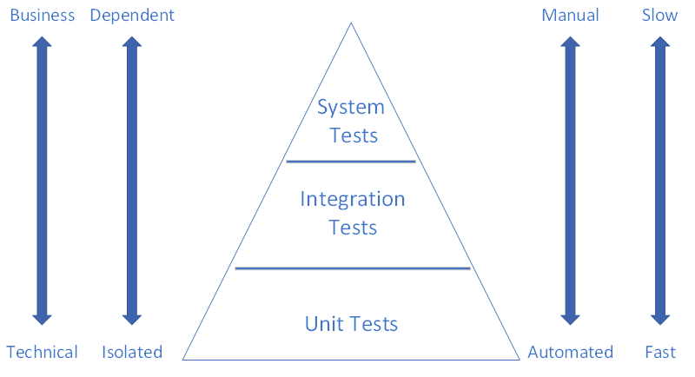
Test Pyramid

Slide 16
Test Types

Slide 17
Test Types
Software Testing Type is a classification of different testing activities into categories, each having, a defined test objective, test strategy, and test deliverables

Slide 18
Test Types

Slide 19
Static Testing
Static testing is the testing of the software work products manually, or with a set of tools, but they are not executed.
Static Analysis
  Using a tool to evaluate the Item Under Test
Review
  Manual evaluation of the Item Under Test

Slide 20
Test Types

Slide 21
Dynamic Testing
White-box Test or Structured-based testing
  In white-box testing the tester is concentrating on how the software is put together.
  The internal structure of the software is known by the tester
Black Box Testing or Specification-based testing
  In black-box testing the tester is concentrating on what the software does, not how it does it.
  The internal structure of the software is not known by the tester

Slide 22
Grey box Testing
We make assumptions about the internal structure of the software

Slide 23
Test Types

Slide 24
Black box Testing
Functional testing
  Functional testing is a type of testing which verifies that each function of the software application operates in conformance with the requirement specification.
  What the system does
Non-functional testing
  Non-functional testing is a type of testing to check non-functional aspects of a software application. It is explicitly designed to test the readiness of a system as per nonfunctional parameters which are never addressed by functional testing.
  How well the system does it

Slide 25
Non-functional Testing - Performance Testing
Load testing - checks the application's ability to perform under anticipated user loads. The objective is to identify performance bottlenecks before the software application goes live.
Stress testing - involves testing an application under extreme workloads to see how it handles high traffic or data processing. The objective is to identify the breaking point of an application.
Endurance testing - is done to make sure the software can handle the expected load over a long period of time.

Slide 26
Non-functional Testing - Maintainability Testing
It basically checks how easy it is to maintain the system. How easy it is to analyze, change and test the application or product.
  Update/patch install and uninstall processes don’t work
  Configurations can’t be changed appropriately
  Code not maintainable
  Software is not efficiently testable

Slide 27
Usability Testing
In usability testing basically the testers tests the ease with which the user interfaces can be used. It tests that whether the application or the product built is user-friendly or not
  Learnability: How easy is it for users to accomplish basic tasks the first time they encounter the design?
  Efficiency: How fast can experienced users accomplish tasks?
  Memorability: When users return to the design after a period of not using it, does the user remember enough to use it effectively the next time, or does the user have to start over again learning everything?
  Errors: How many errors do users make, how severe are these errors and how easily can they recover from the errors?
  Satisfaction: How much does the user like using the system?

Slide 28
Portability
Testing the ease with which a computer software component or application can be moved from one environment to another
  Hardware
  Operating system
  Browser

Slide 29
Other Non-functional testing types
Disaster recovery
Security
Localization
Data Quality
And many others

Slide 30
Test Types

Slide 31
Change related tests
Confirmation Test
  When a test fails because of the defect then that defect is reported, and a new version of the software is expected that has had the defect fixed
Regression Test
  Making sure that the changes did not break existing functionality

Slide 32
Thank you for your attention!

